Slide 1
Scientific figures seminar – Part 1
William F. Lamb
Jérôme Hilaire

Slide 2
Organisation
General principles for making figures (Will, 20 mins)
Practical introduction to Inkscape (Jerome, 20 mins)
Discussion (20 mins)
Hang around after if you want specific help

Slide 3
General principles (what we have learned*)
Identify a key message, communicate it:
  Base graph selection
  Layout and storytelling
  Colour
  Icons
  Simplify
* Caveat: we are still learning!

Slide 4
Choose the right base graph

Slide 5
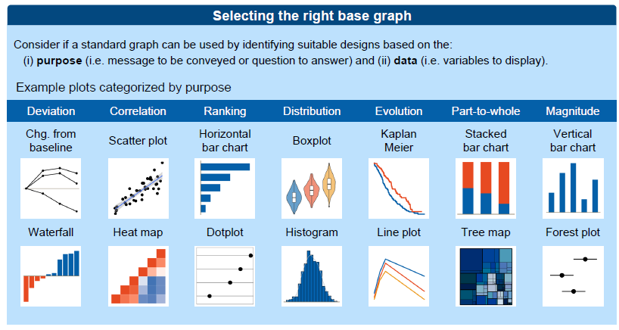
Base graph selection: quantitative
Resources
  Cheat Sheet: https://github.com/mcc-apsis/figures/blob/master/Resources/Readings/CheatSheet.pdf
  Visualisation catalogue: https://datavizcatalogue.com/search.html
Be aware: humans are bad at interpreting data based on volume, colour, depth (“Cleveland-McGill scale”)

Slide 6
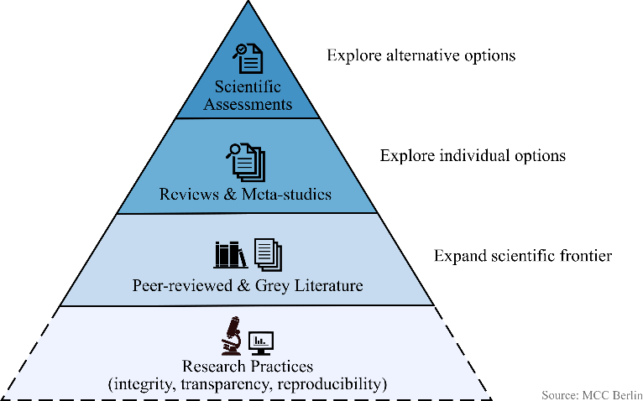
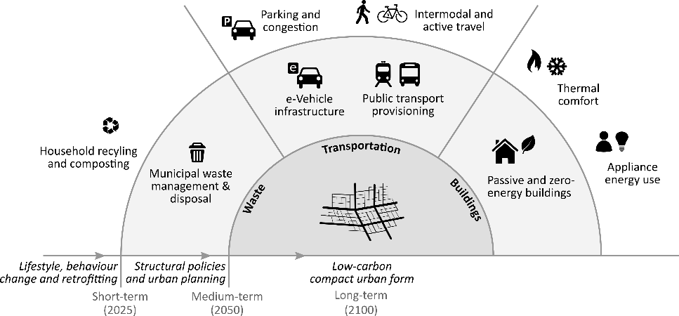
Base graph selection: qualitative
No rules!
Flow diagrams, Venn diagrams are common
Use shapes?

Slide 7
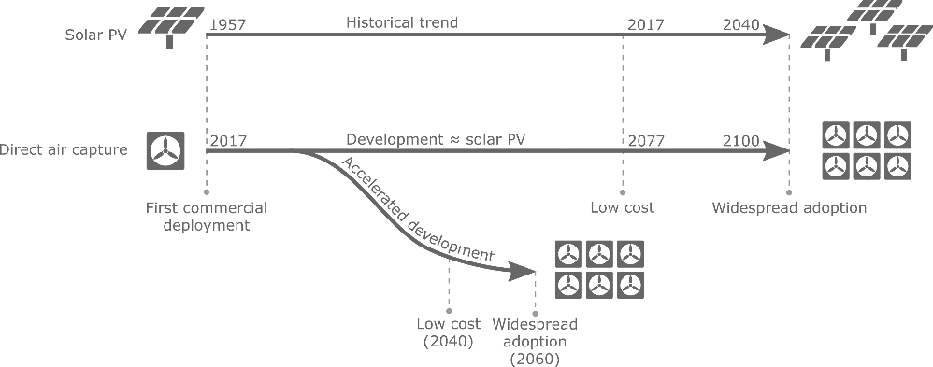
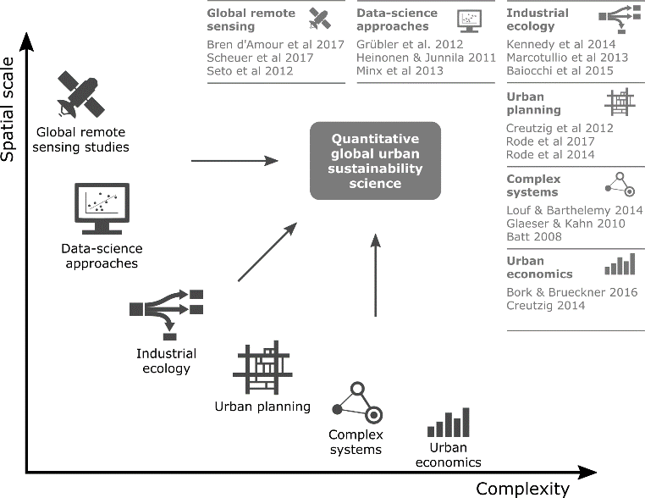
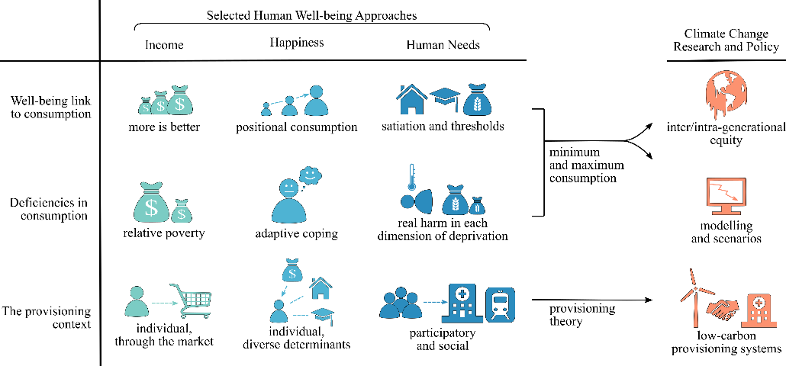
Base graph selection: qualitative
Use scientific forms: axes, tables, etc.

Slide 8
Use layout and tell a story

Slide 9
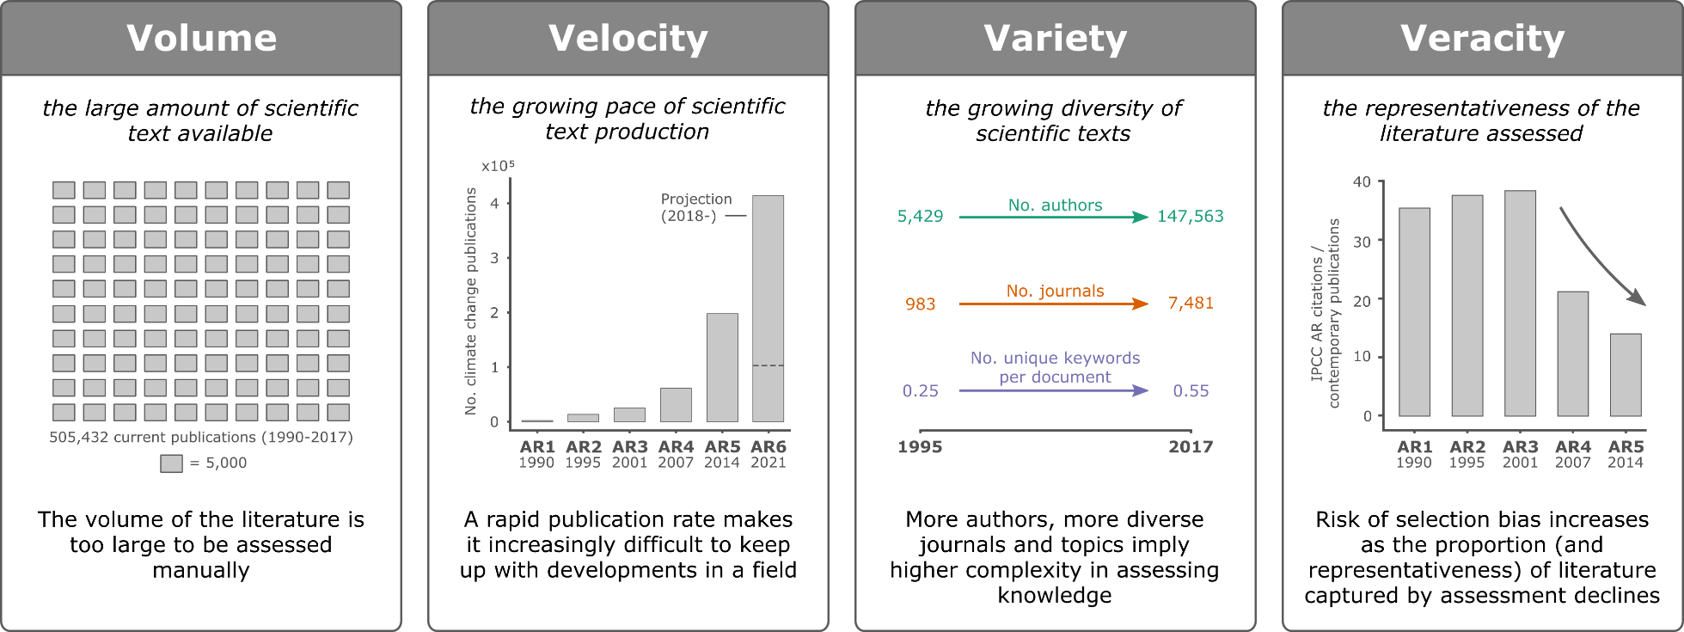
Layout and storytelling
Division, repetition

Slide 10
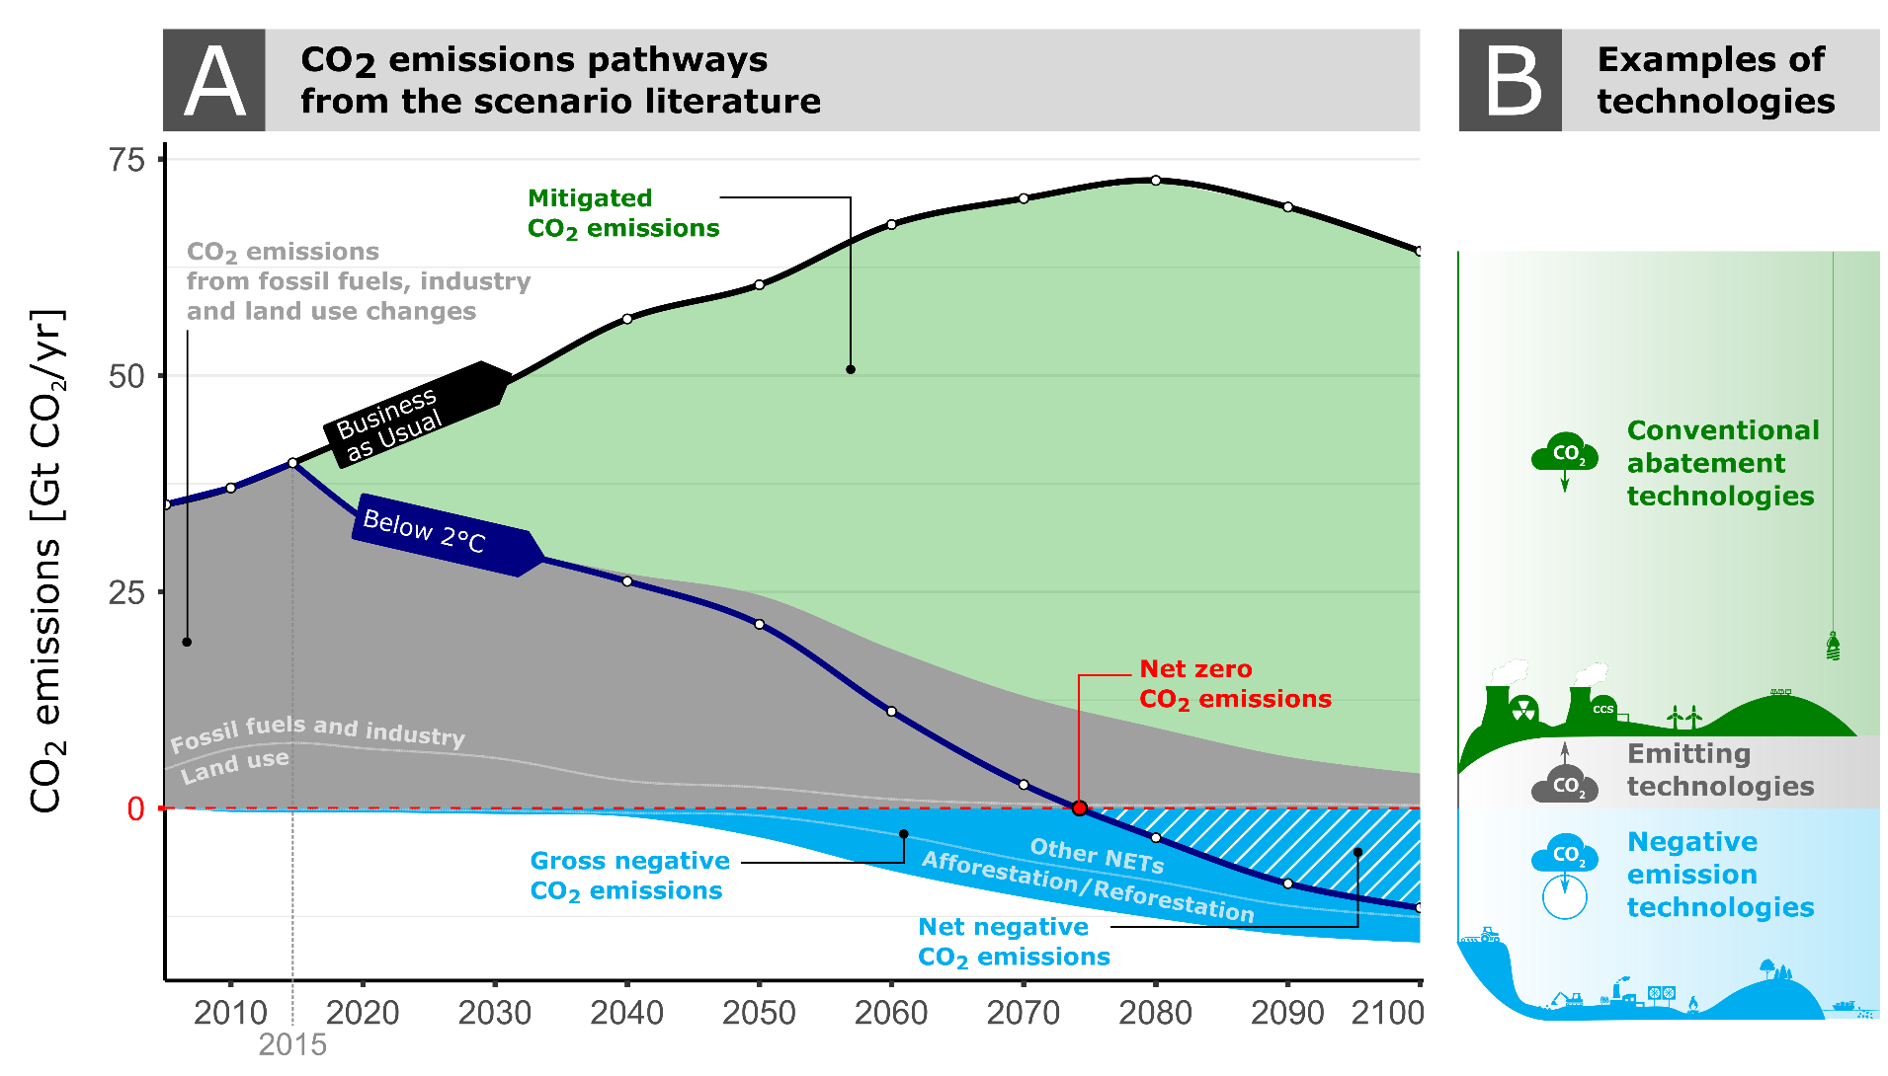
Layout and storytelling
Explanations, annotations

Slide 11
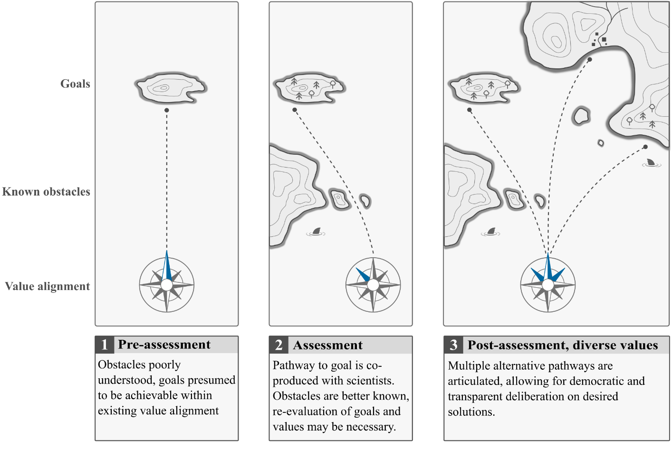
Layout and storytelling
Sequences

Slide 12
Use colour

Slide 13
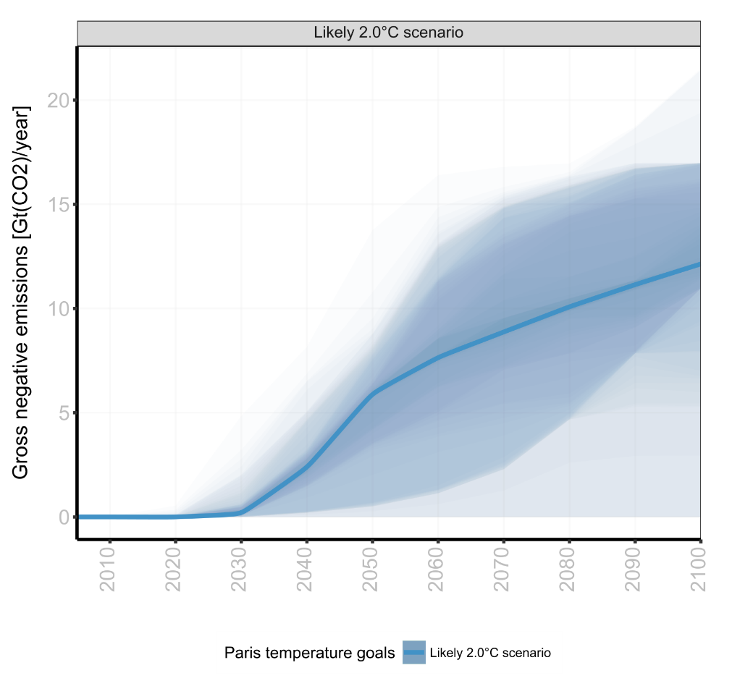
Colour
For emphasis

Slide 14
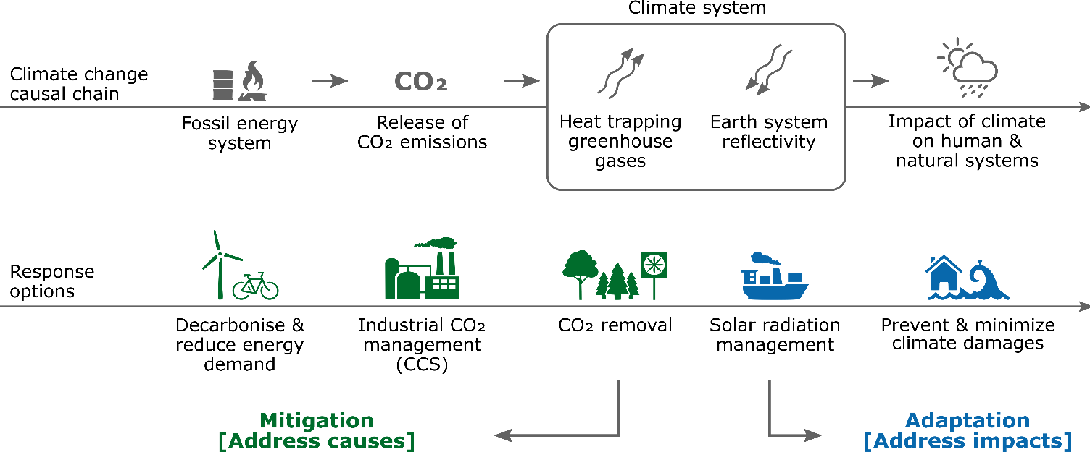
Colour
For distinction

Slide 15
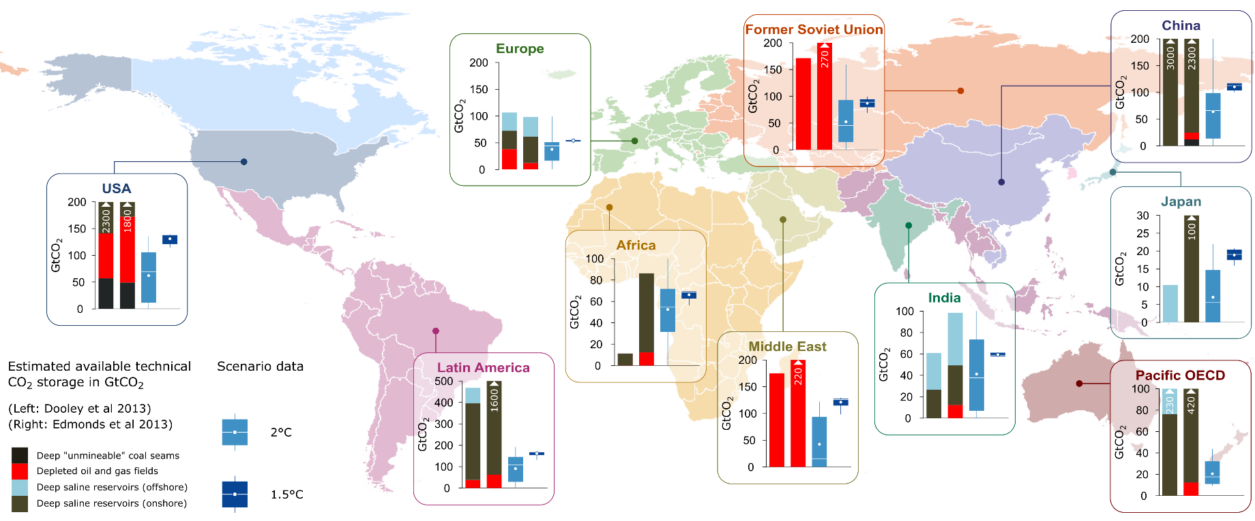
Colour
For distinction

Slide 16
Colour
Avoid defaults (rainbow, jet)
Be aware of colour blindness
Use colorbrewer2.org (also via libraries in python/r)
Plenty of discussions
  https://blog.datawrapper.de/colors/
  http://www.visualisingdata.com/2015/01/make-grey-best-friend/

Slide 17
Use icons

Slide 18
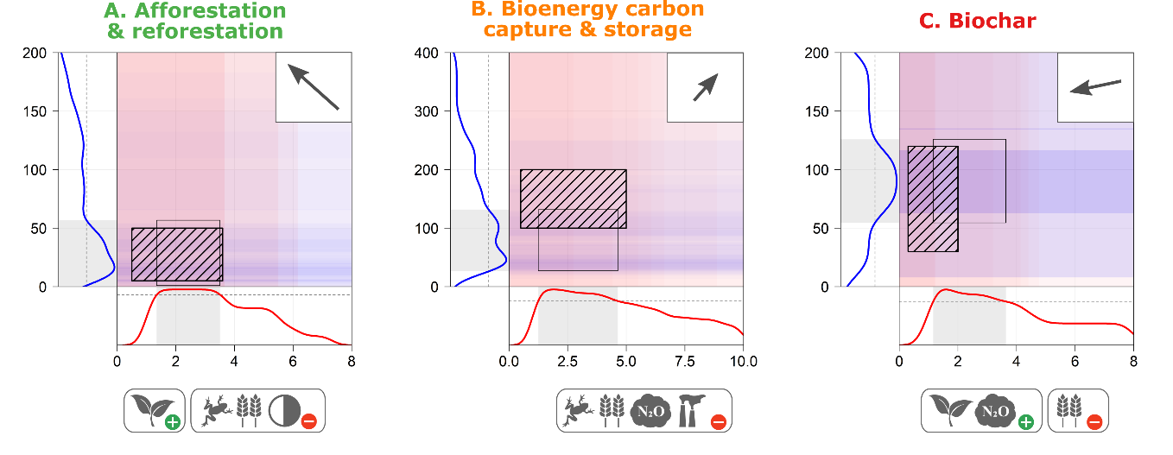
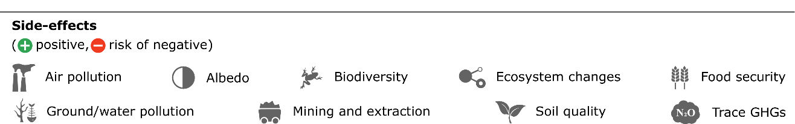
Icons
For concise labelling

Slide 19
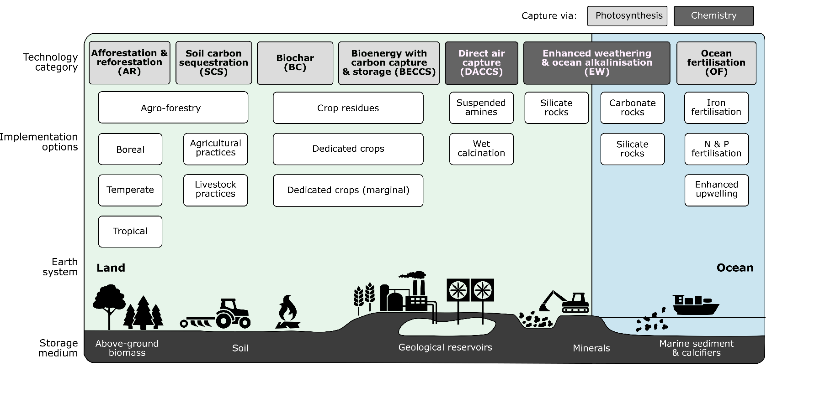
Icons
For jazzing up boring stuff?

Slide 20

Icons
Our library: https://github.com/mcc-apsis/figures/tree/master/Resources/Small%20icons

Slide 21
Simplify

Slide 22
Simplify
Remove or mute colours, backgrounds, borders
Avoid angled and vertical text
Avoid overlapping parts
Arrows for causal relationships ( ), circles for labelling ( )
Be consistent (font, style)

Slide 23
What role do negative emissions play in 2oC scenarios?

Slide 24
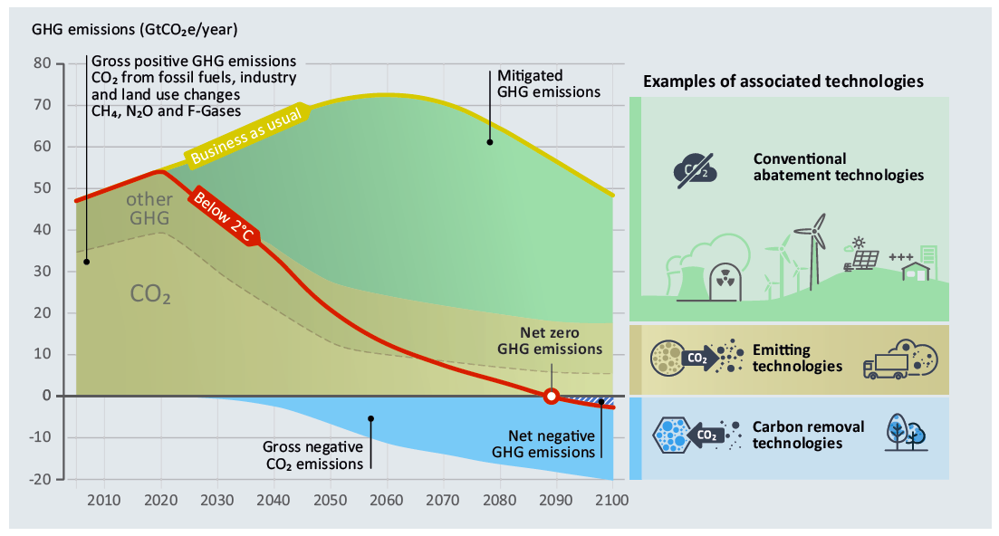

Slide 25
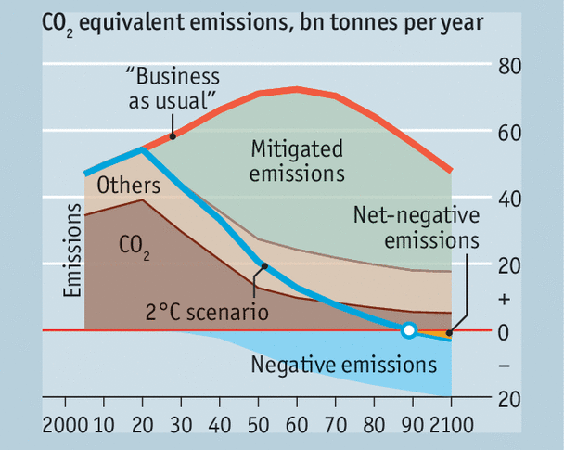

Slide 26
Thanks

